Slide 1
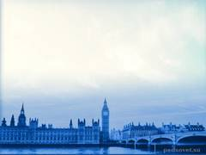
Интерактивная викторина
по английскому языку
«Страноведческий калейдоскоп»
Разработала
Амброс Елена Ростиславовна
Учитель английского языка
МОУ «Шумиловская СОШ

Slide 2
Knowledge of languages
and cultures
is the door to wisdom

Slide 3
General Information
10
20
30
40
50
10
Geography
10
20
30
40
50
History
10
20
30
40
50
Literature
10
20
30
40
50
Famous People
10
20
30
40
50
Traditions
10
20
30
40
50

Slide 4
10
What are the Islands where the UK
is located?

Slide 5
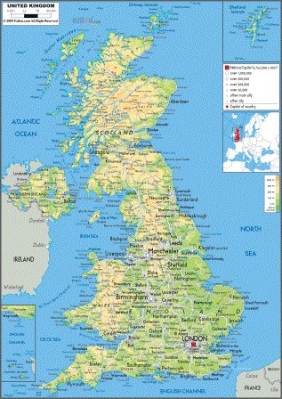
The British Isles
BACK

Slide 6
20
What are the official languages in Canada?

Slide 7
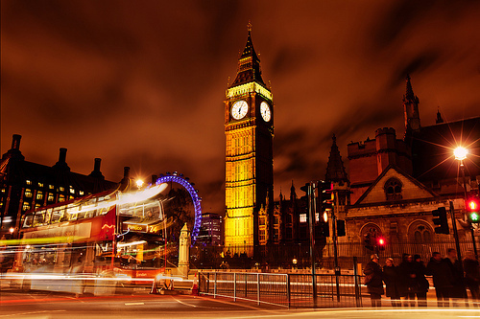
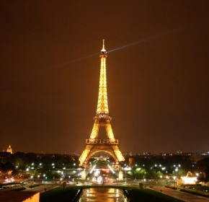
BACK

Slide 8
30
Where does the British Premier live and work?

Slide 9
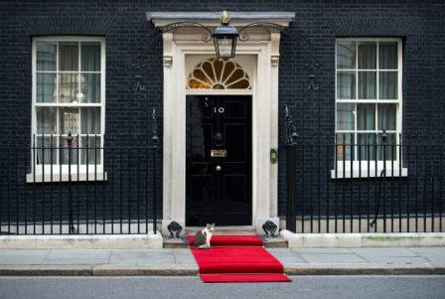
At 10 Downing Street
BACK

Slide 10
40
What is the nickname
of the British flag?

Slide 11
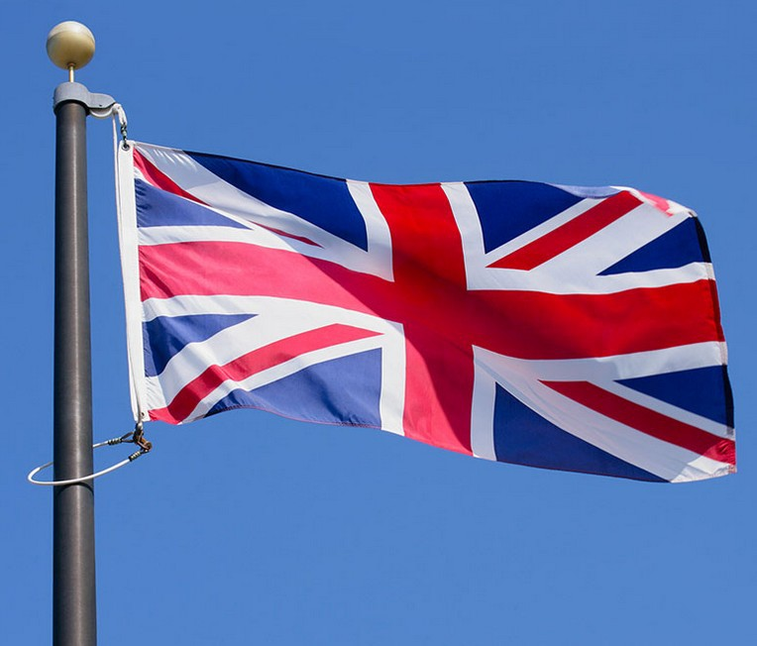
The Union Jack
BACK

Slide 12
50
Who is a very famous person in the UK who has no right to influence the political decisions of Parliament?

Slide 13
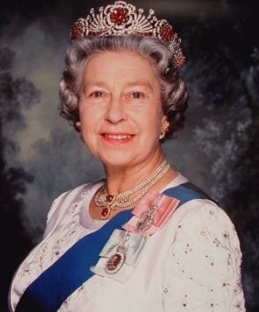
The Queen of the UK
BACK

Slide 14
10
What oceans is
the USA washed by?

Slide 15
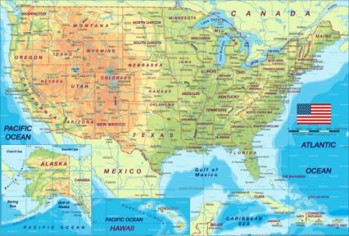
The Pacific Ocean in the west
The Atlantic Ocean in the east
BACK

Slide 16
20
What city
does the zero meridian
pass through?

Slide 17
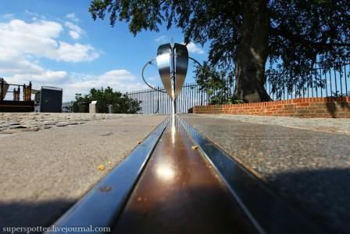
Greenwich
BACK

Slide 18
30
What is the largest state of the USA?

Slide 19
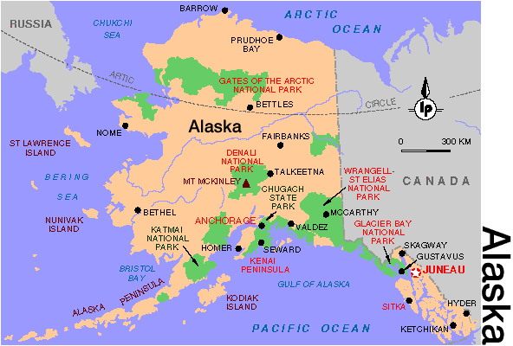
BACK

Slide 20
40
What city was built on the banks of the Potomac river?

Slide 21
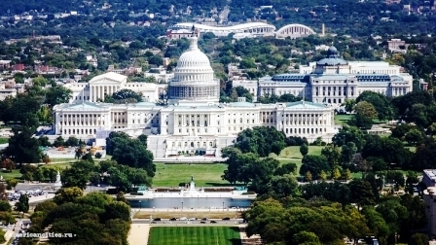
Washington
BACK

Slide 22
50
Which part of
Great Britain is famous for its Highland Games?

Slide 23
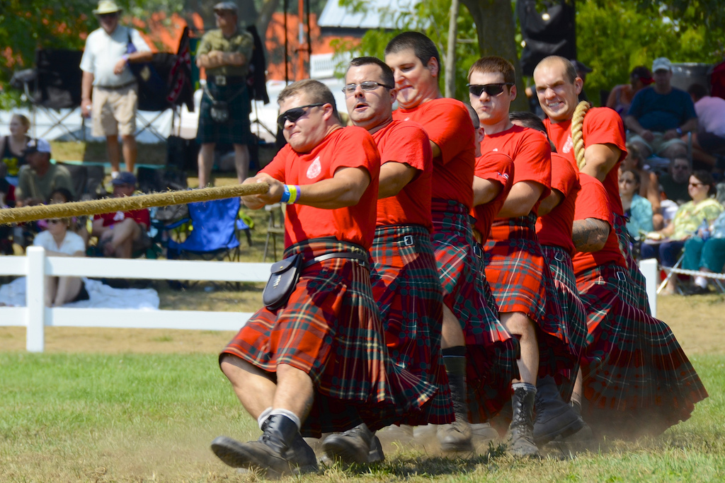
Scotland
BACK

Slide 24
10
The legend says that without them the Tower will fall. Who are they?

Slide 25
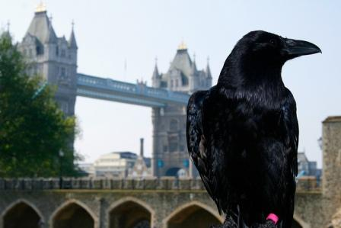
The ravens
BACK

Slide 26
20
In 1455-1485 in England, a terrible war broke out, which lasted for 30 years. The struggle for power was between the supporters of the two branches of the Plantagenet dynasty - the Lancasters and the Yorks. What was the name of this war?

Slide 27
The Wars of the Roses
BACK

Slide 28
30
Name the prehistoric monument located in the English county of Wiltshire erected about 2200 BC

Slide 29
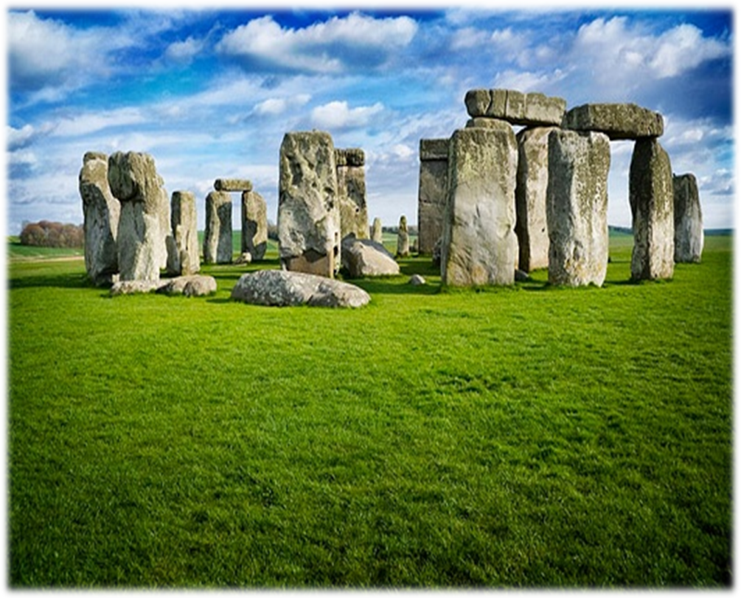
Stonehenge
BACK

Slide 30
40
Which city in the state of Florida has the same name as a Russian city?

Slide 31
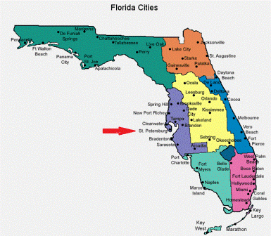
St. Petersburg
BACK

Slide 32
50
What was the name of the most famous legendary knight community in ancient Britain and who was its head?

Slide 33
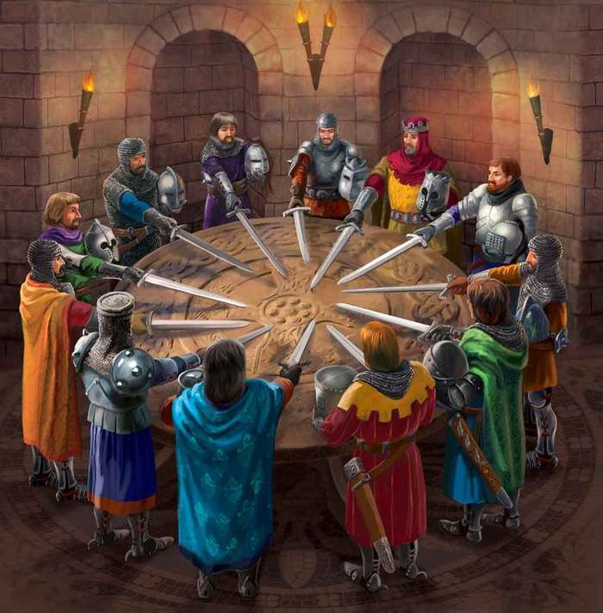
The Knights of the Round Table
King Arthur
BACK

Slide 34
10
Who is the author of the literary treasure
"Alice in Wonderland"?

Slide 35
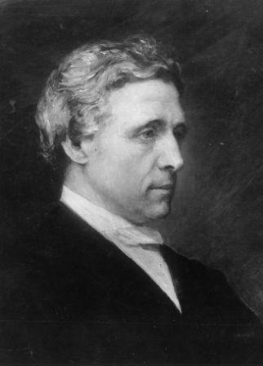
Lewis Carroll
BACK

Slide 36
20
Name an English poet and writer who wrote beautiful poems called sonnets

Slide 37
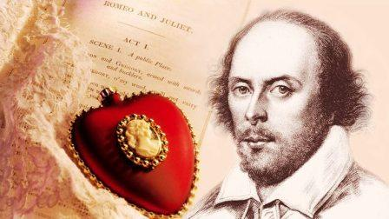
William Shakespeare
BACK

Slide 38
30
Who is the most popular hero of English ballads?

Slide 39
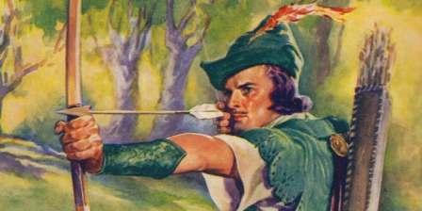
Robin Hood
BACK

Slide 40
40
What British writer is the author of the fantasy tales "The Hobbits" and
"The Lord of the Rings?

Slide 41
John Ronald Reuel Tolkien
BACK

Slide 42
50
Name the famous Shakespeare's play where the main character is
a Danish prince.

Slide 43
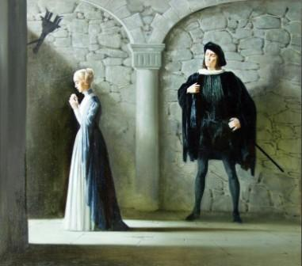
“Hamlet”
BACK

Slide 44
10
What was Sherlock Holmes’ address ?

Slide 45
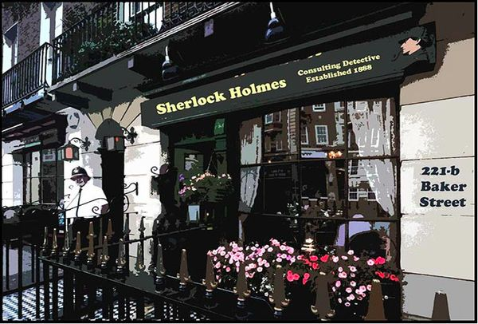
221-b Baker Street
BACK

Slide 46
20
Who was the leader of the world famous group “The Beatles”?

Slide 47
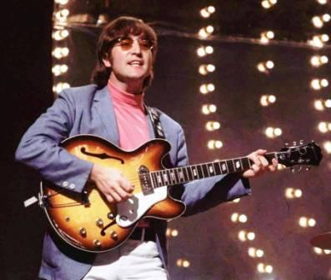
John Lennon
BACK

Slide 48
30
These are the names of the brothers and sisters who together have achieved success in certain areas. You need to relate people and the field of their activities.
Serena and Venus Williams - literature
Harry, Albert, Sam and Jack Warner - sport
Charlotte, Emily and Anne Bronte - aviation
Wilbur and Orville Wright - film industry

Slide 49
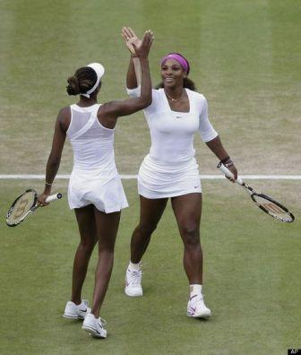
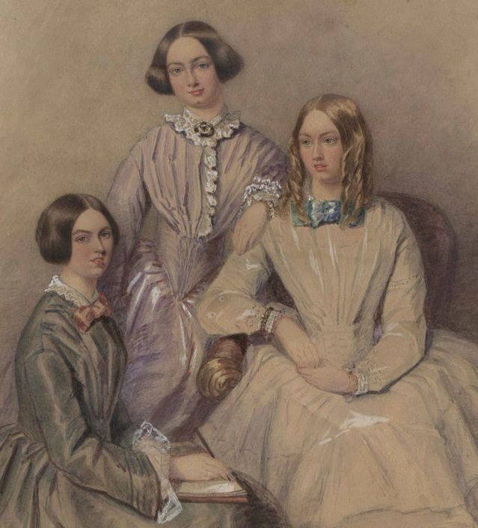
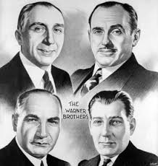
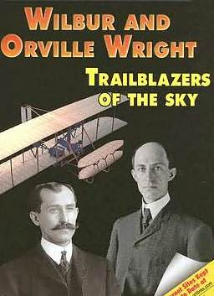
Serena and Venus Williams - sport
Harry, Albert, Sam and Jack Warner - film industry
Charlotte, Emily and Anne Bronte - literature
Wilbur and Orville Wright - aviation
BACK

Slide 50
40
What was the name of the famous English halfback, who was the captain of the England national football team from 2000 to 2006 and played 100 matches in the UEFA Champions League?

Slide 51
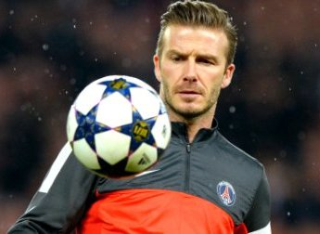
David Beckham
BACK

Slide 52
50
Who defeated the French at the
Battle of Trafalgar, whose statue is erected on the top of the column on Trafalgar square?

Slide 53
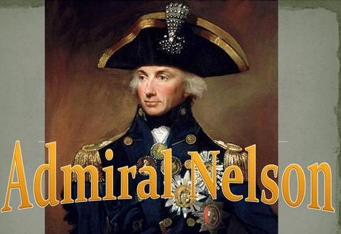
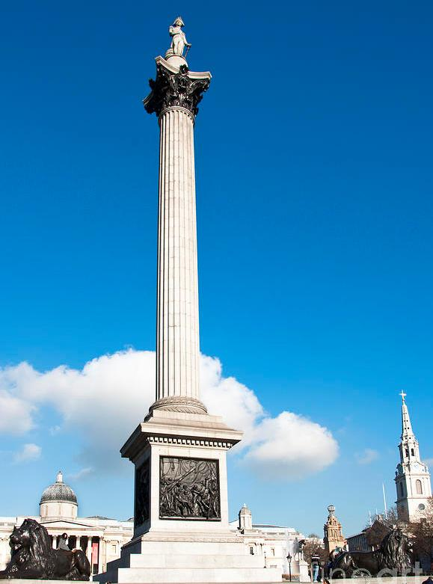
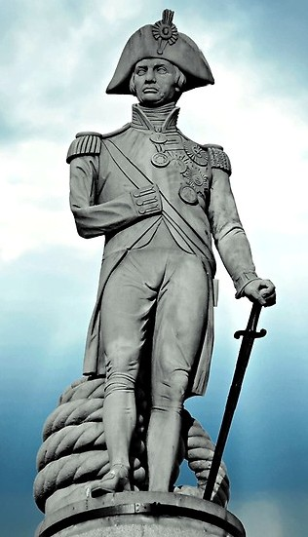
BACK

Slide 54
10
What is a traditional bag
for Christmas presents?

Slide 55
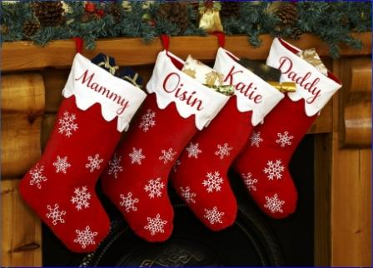
Long socks called
“Christmas stockings”
BACK

Slide 56
20
When can you see the flag over the Queen’s Palace?

Slide 57
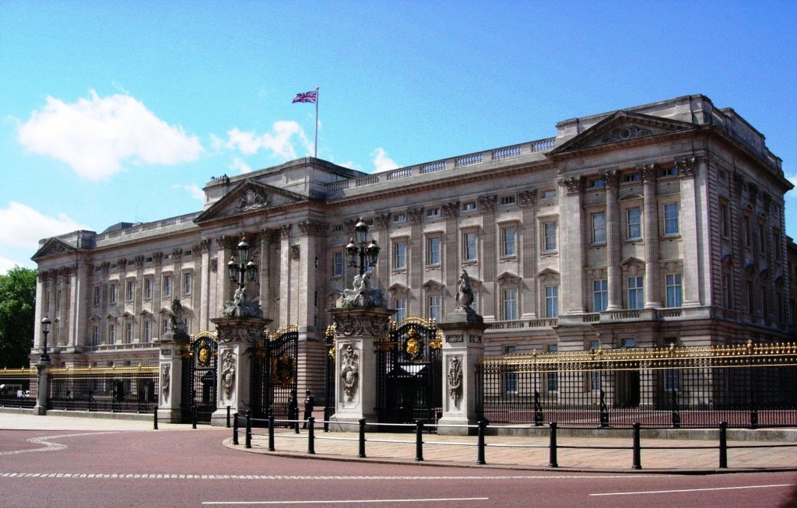
When the Queen is at home
BACK

Slide 58
30
Where does
The Changing of the Guard take place?

Slide 59
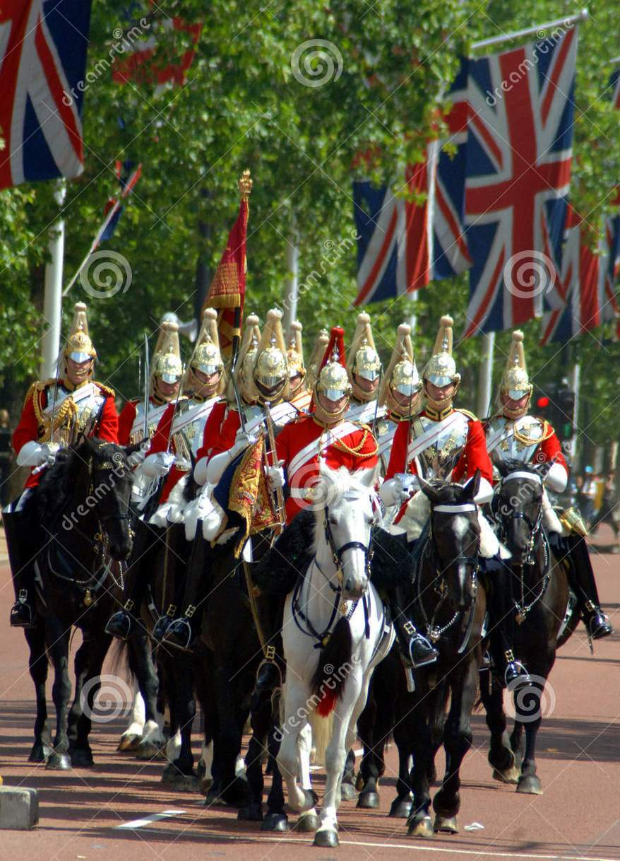
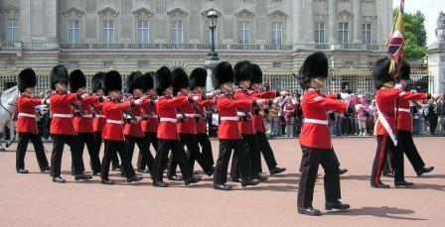
In the Forecourt of Buckingham Palace
BACK

Slide 60
40
When do the English people usually drink tea?

Slide 61
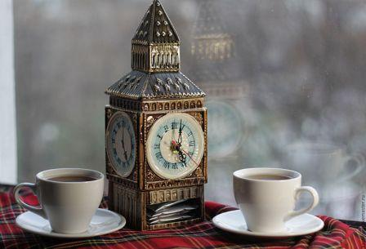
At 5 o’clock
BACK

Slide 62
50
What holiday
do the British celebrate
on the 5th of November?

Slide 63
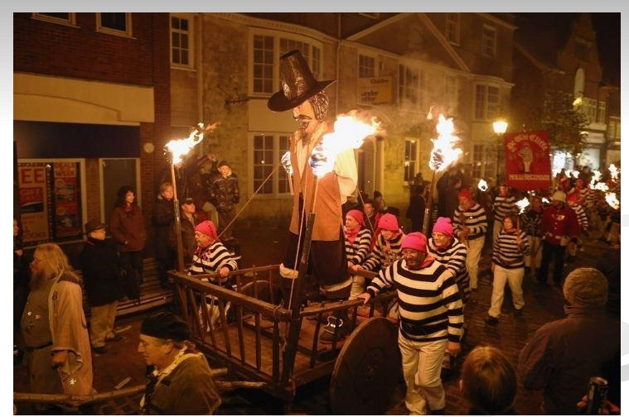
Guy Fawkes’ Night
BACK

Slide 64
BACK

