Slide 1

School supplies

Slide 2
HOMETASK
EX. 5-7 P. 115
P. 103, 106 УЧИТЬ СЛОВА

Slide 3


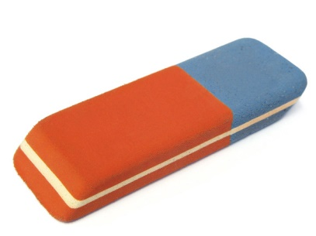

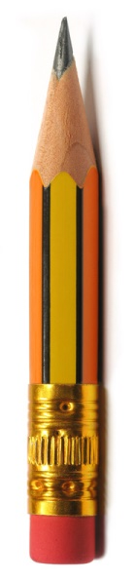
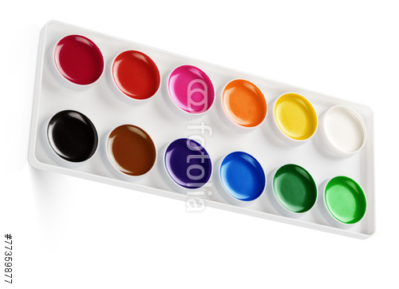
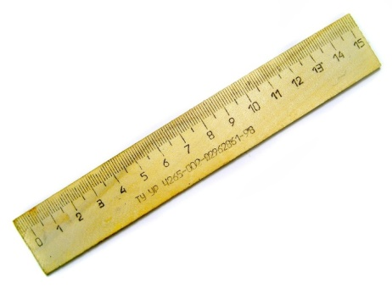
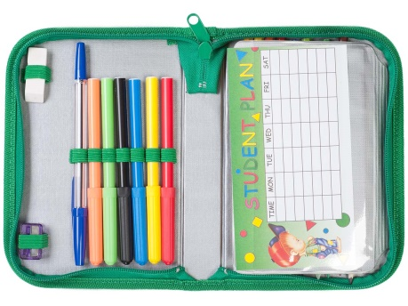
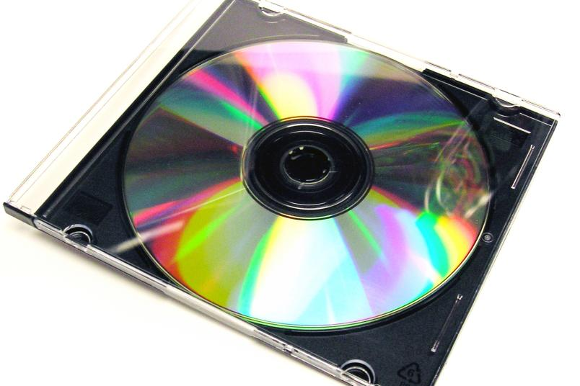
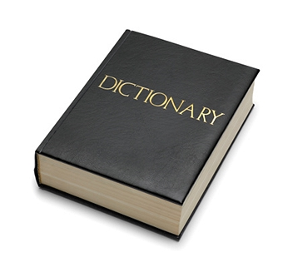
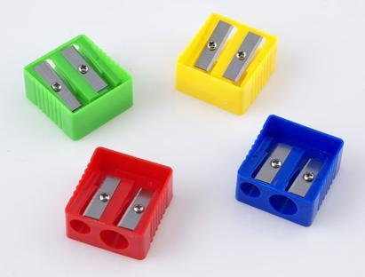
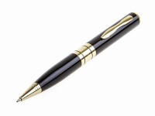
The things you can use in the lesson
rubber
textbook
workbook
pencil
ruler
pencil box
paints
CD
pencil
sharpener
pen

Slide 4
What is missing?

Slide 5
What is missing?
a pen

Slide 6
What is missing?

Slide 7
What is missing?
pencil box

Slide 8
What is missing?

Slide 9
What is missing?
text book

Slide 10
You can watch it in the lesson
and at home
DICTIONARY
PENCIL BOX
RUBBER
VIDEO
Notes:
MATCH THE WORDS

Slide 11
You can paint colourful pictures
using them
CD
PENCIL BOX
PEN
PAINTS

Slide 12
You can read new texts and do
many exercises using it
TEXTBOOK
DICTIONARY
PENCILBOX
PAINTS

Slide 13
You can put your pens, pencils
and rubbers in it
PENCIL SHARPENER
DICTIONARY
PENCIL BOX
PAINTS

Slide 14
You can write your homework
using it
RUBBER
PAINTS
PENCIL
PEN

Slide 15
You can rub words and lines
using it
RUBBER
PAINTS
PENCIL
PEN

Slide 16
You can translate new words
using it
TEXTBOOK
WORKBOOK
DICTIONATY
VIDEO

Slide 17
You can listen, repeat and learn
new words using it
TEXTBOOK
WORKBOOK
CD
VIDEO

Slide 18
PUT SOMETHING IN YOUR BAG
Example: Have you got a sharpener
in your bag?
Yes, I have No, I have not

Slide 19
COUD YOU GIVE ME
A RED PENCIL, PLEASE?
YES. HERE YOU ARE.
THANK YOU.

Slide 20
COULD YOU GIVE ME
A RUBBER?
I’M AFRAID I LEFT IT AT HOME.
IT’S OK. I’LL ASK DASHA

Slide 21

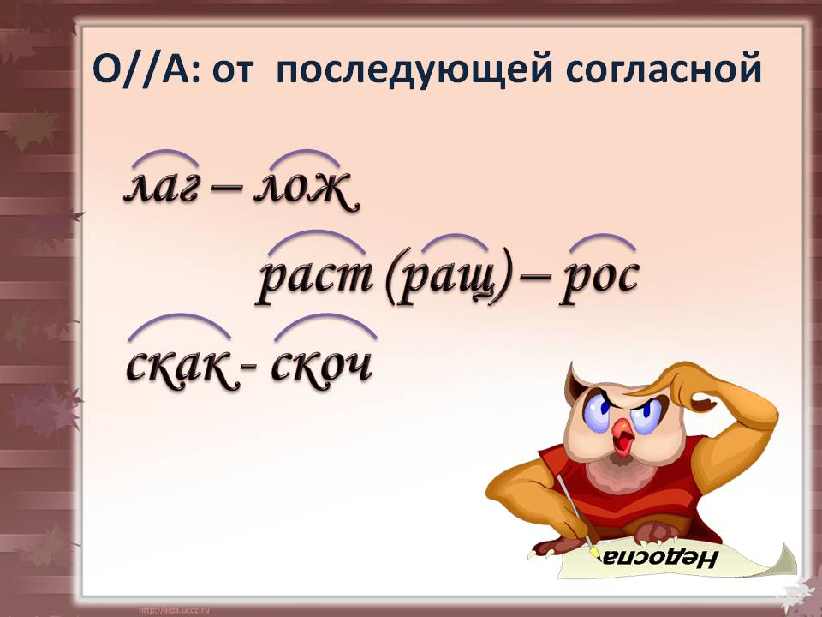
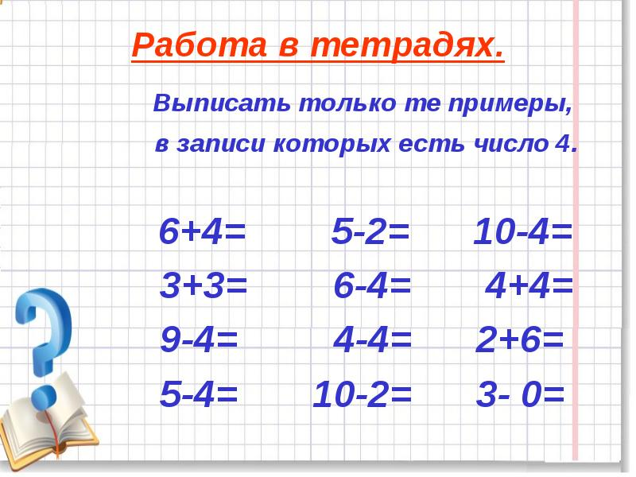

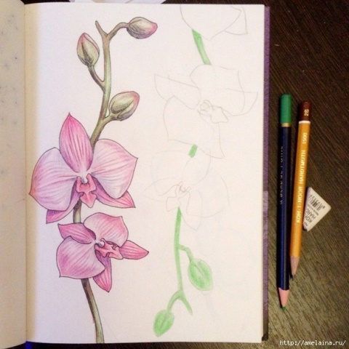


GUESS WHAT SUBJECT IT IS
Russian English Reading
Art PE Music Maths

